Slide 1


ALY6080
Final Presentation
Harnessing Data to Drive Growth:
An Analysis of Locally Inspired's Sales
2023/08/22
Team 2
Hanchen Xu xu.hanc@northeastern.edu
Haoran Wang wang.haoran4@northeastern.edu
Puchang Yin yin.pu@northeastern.edu
Zihan Ma ma.zihan1@northeastern.edu
1

Slide 2
Executive Summary
Business ProblemS
Analytics & Visuals
Synthesis of the Data
Recommendations & Findings
Future Research
Conclusion
2

Slide 3
Business Problems
Effectiveness of Promotional Discounts
Optimizing Customer Acquisition and Retention
Seasonal Product Sales and Inventory Management
Negative profit issues
3

Slide 4
Main Data Cleaning Process
Step 1: Remove all columns that have NAs for every row.
Step 2: Added code to choose either remove columns that have no effects on the problems we want to solve (Tax, ID, Phone number. Etc.) or keep them.
Step 3: Randomly separate 30% of the data for faster graph building. The whole dataset will need a few minutes for graphing without separating.
Step 4: In the Financial Status and Fulfillment Status column. Select records that are paid and fulfilled. This step removed about 45% of records that are not related to our topic.
Step 5: Remove rows that have most columns missing, also the columns have only one unique value.
Step 6: Separate the dataset into two: online orders and shop orders.
Step 7: Apply the same steps to the whole dataset. The processed dataset is used for the project.
Step 8: Monthly inventory can be combined into the processed dataset using the SKU column.
4

Slide 5
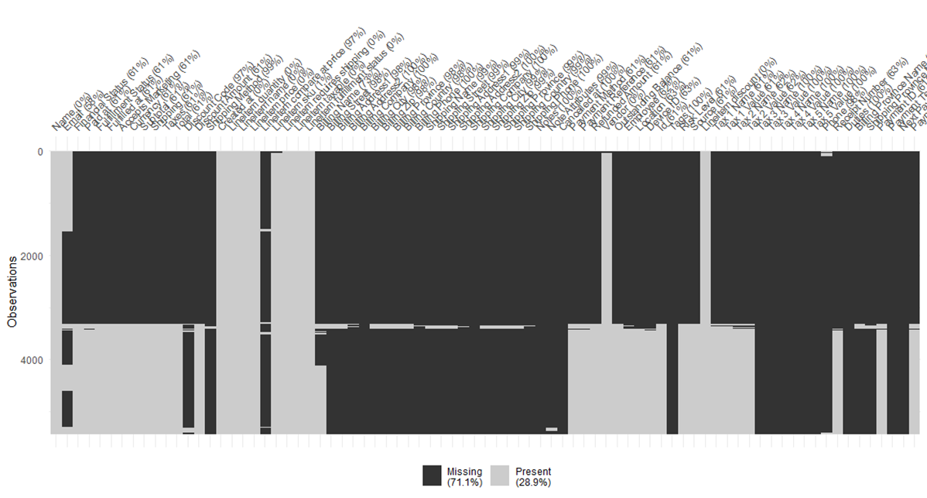
Missing Value Situation Before/After Data cleaning
The dataset before cleaning. It is sorted by missing data patterns.
5

Slide 6
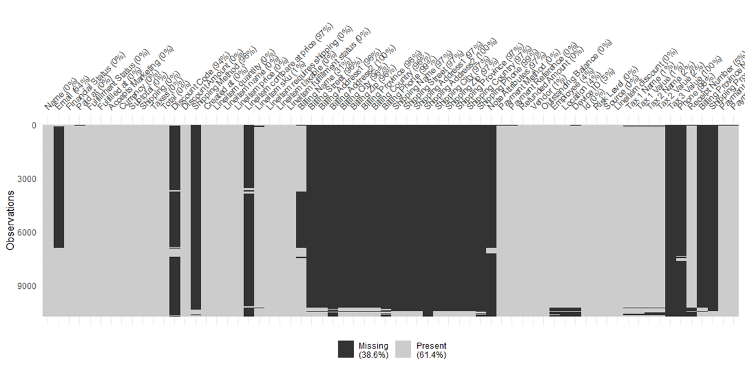
Missing Value Situation Before/After Data cleaning
The final data set which used to build visualizations.
The dataset is mostly cleaned at the moment.
Most black(Missing) here is because it includes the online sales data.
6

Slide 7
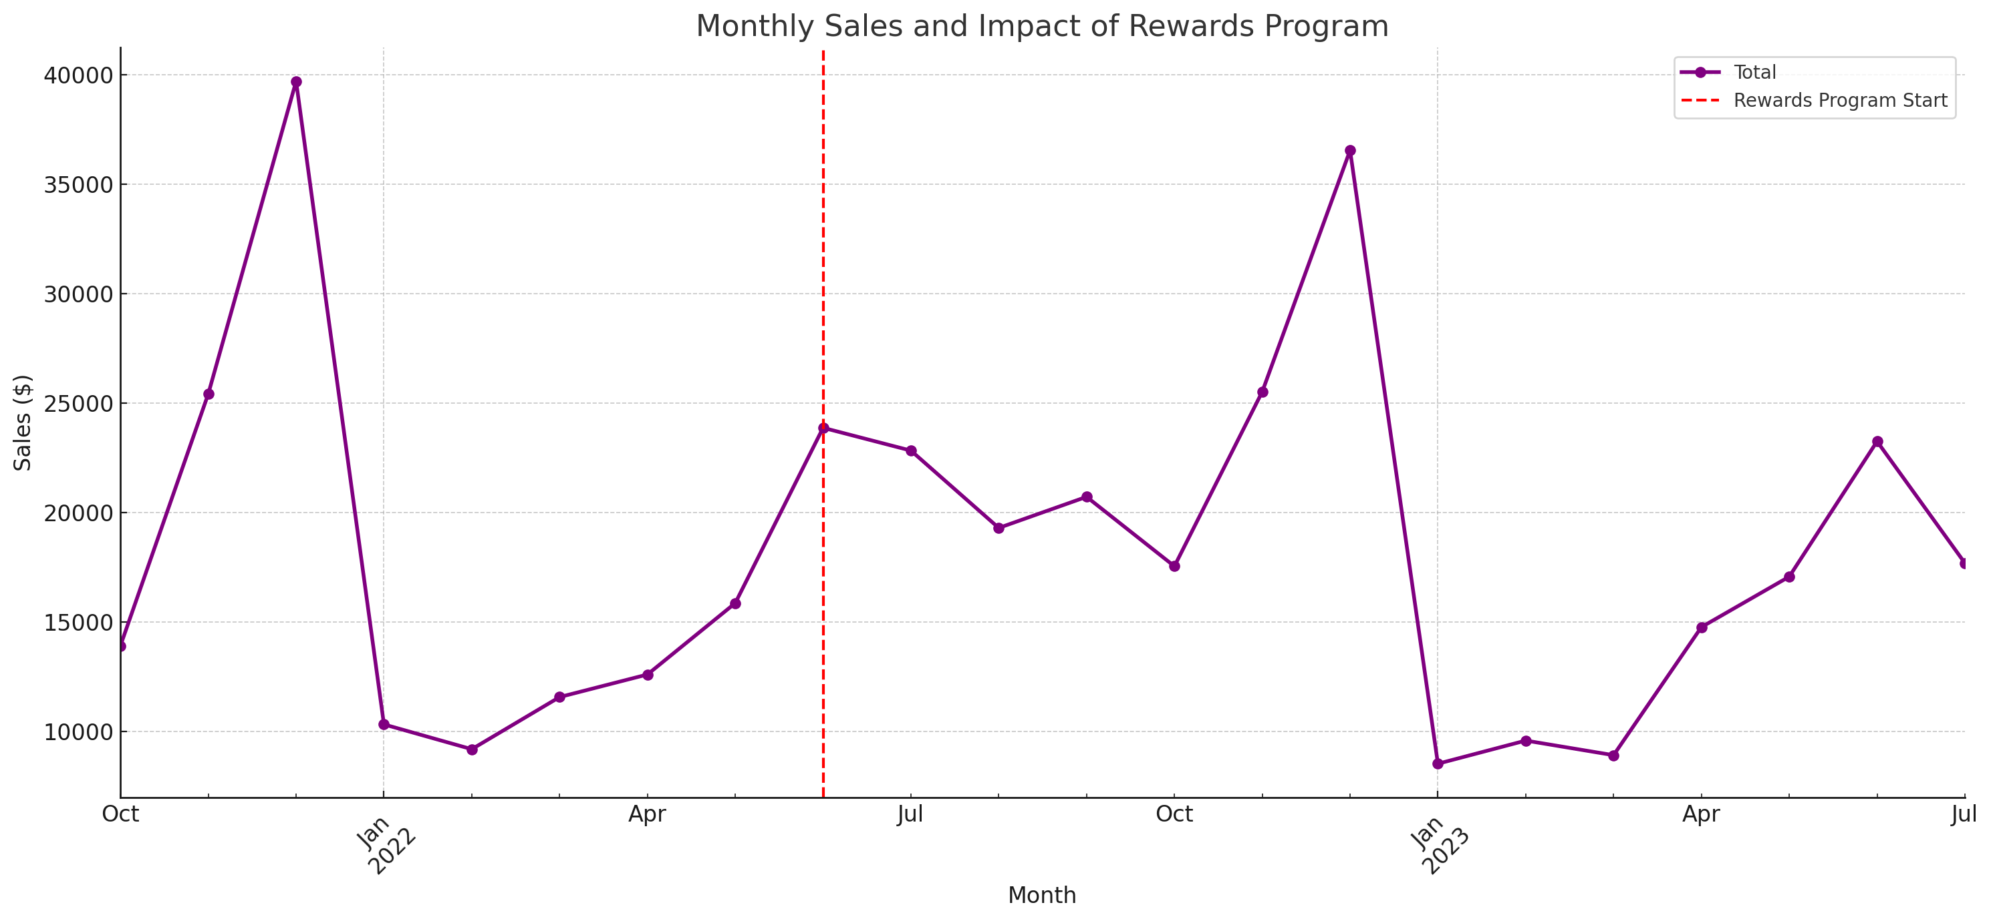
Effectiveness of Promotional Discounts
Here's the line chart showcasing Monthly Sales & Introduction of the Rewards Program. The red dashed line indicates the introduction of the rewards program in June 2022, allowing for a visual comparison of sales before and after its implementation.
7

Slide 8
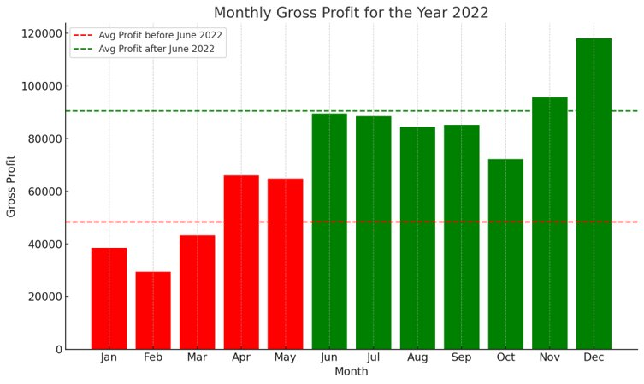
Effectiveness of Promotional Discounts (cont.)
First Half vs. Second Half: There's a noticeable increase in monthly gross profit after June 2022. Specifically, the average monthly profit before June stood at approximately $48,402.45, while it rose to around $90,515.23 after June.
Ascending Trend: The chart indicates an upward trajectory in gross profit as the year progresses.
Comparative Monthly Gross Profit Before and After June 2022
8

Slide 9
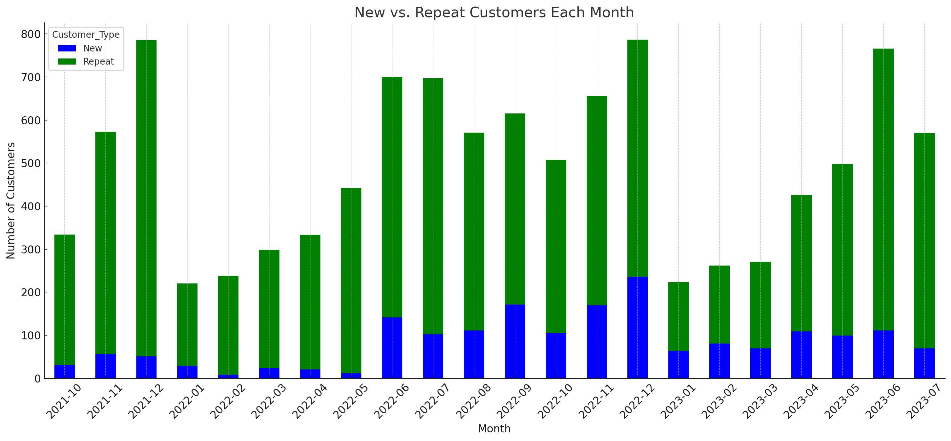
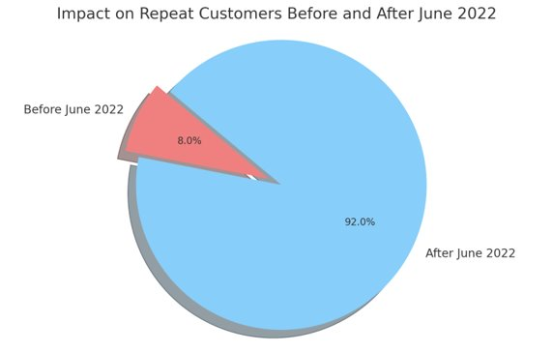
Optimizing Customer Acquisition and Retention
Here's the stacked bar chart comparing the number of New vs. Repeat Customers Each Month. The blue bars represent new customers, while the green bars indicate repeat customers.
Here's the pie chart showcasing the impact on repeat customers before and after June 2022.
9

Slide 10
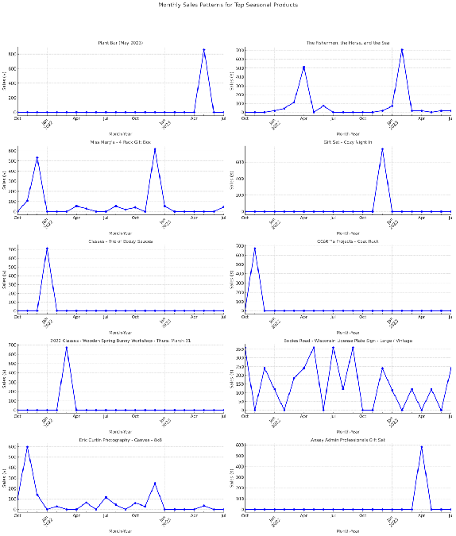
Seasonal Product Sales and
Inventory Management
Sales Patterns Insights:
"Plant Bar (May 2023)" has a clear peak in May 2023, indicating a specific event or season influencing its sales.
"The Fishermen, the Horse, and the Sea" shows consistent sales with sporadic peaks, suggesting occasional promotions or events.
Products like "Miss Mary's - 4 Pack Gift Box" and "Gift Set - Cozy Night In" have distinct peak periods, emphasizing their seasonal nature.
10

Slide 11
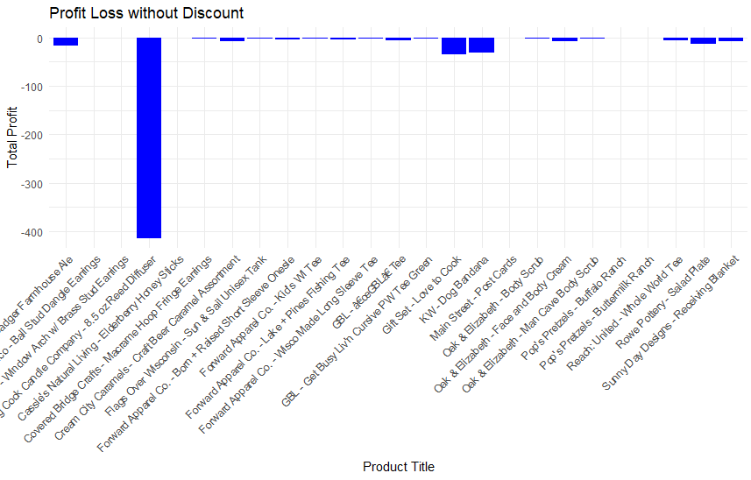
Negative profit issues
All items in this graph need attention.
Even without any discount, selling these items are losing money.
Big Cock Candle Company - 8.5 oz Reed Diffuser is the biggest part in expense.
11

Slide 12
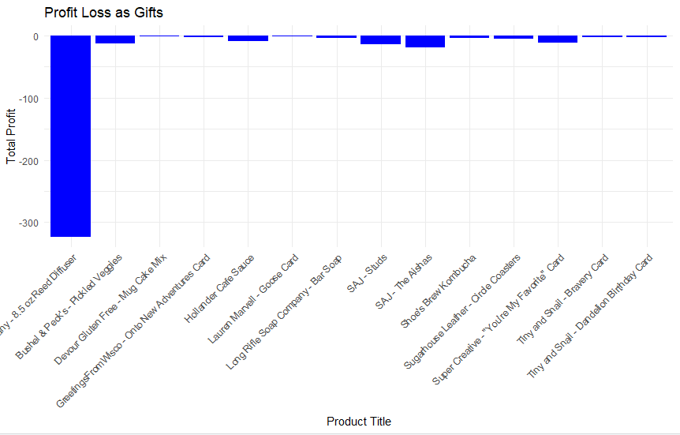
Negative profit issues (cont.)
"Big Cock Candle Company - 8.5 oz Reed Diffuser" costs the most (more than $300)as a gift.
Most dates with negative profits are because of sending gifts but not selling enough items.
12

Slide 13
Recommendations & Findings
Promotional Discounts:
Observe a correlation between heavy discounts and negative profits.
Consider restructuring promotions to ensure profitability.
Customer Retention:
Significant growth in repeat customers post-June 2022.
Enhance personalized marketing, like tailored emails, for greater engagement.
Loyalty Program:
Sales and repeat customers surged after introducing the rewards program in June 2022.
Continuously monitor the program's impact and gather customer feedback for improvements.
Seasonal Products:
Seasonal products display distinct sales peaks.
Adjust inventory based on sales patterns to optimize stock levels.
13

Slide 14
Future Research
Segmentation:
Analyze customer segments for targeted marketing.
Margins:
Study profit margins, especially during promotions.
Feedback:
Implement a system for customer feedback to enhance shopping experience.
Marketing Impact:
Post-implementation, assess the efficacy of personalized campaigns.
Loyalty Program Impact:
Evaluate the long-term effects of the rewards program on loyalty and profit.
Supply Chain:
Understand supply dynamics for better inventory management.
14

Slide 15
Conclusion
Through meticulous data analysis, we've unveiled critical insights into Locally Inspired's sales dynamics. Our findings accentuate the positive influence of promotional strategies, particularly the rewards program launched in June 2022. This initiative not only bolstered sales but also amplified customer retention. However, it's imperative to keep a vigilant eye on the balance between promotions and profitability. Seasonal products, being pivotal sales drivers, require adept inventory management synced with their sales peaks. As we look ahead, leveraging personalized marketing and diving deeper into customer segmentation can be game-changers. In essence, data-driven decisions have the potential to propel Locally Inspired to new heights, fostering both growth and a loyal customer base.
15

Slide 16

Thank You
16

Slide 17
References
Locally Inspired. (2022). Locally Inspired WI. https://locallyinspiredwi.com/
Kusumadewi, S., & Hartati, S. (2019). Predictive analytics to predict customer behavior: A behavior informatics and analytics approach. 2019 International Conference of Artificial Intelligence and Information Technology (ICAIIT).
McKinsey & Company. (n.d.). Marketing & Sales Big Data, Analytics, and the Future of Marketing. McKinsey & Company. Retrieved from https://www.mckinsey.com/~/media/McKinsey/Business%20Functions/Marketing%20and%20Sales/Our%20Insights/EBook%20Big%20data%20analytics%20and%20the%20future%20of%20marketing%20sales/Big-Data-eBook.ashx
17

